Slide 1
Database connectivity in Django

Slide 2
Dbbrowser installation
We have to download the dbbrowser download the dbbrowser from
https://sqlitebrowser.org/dl/

Slide 3
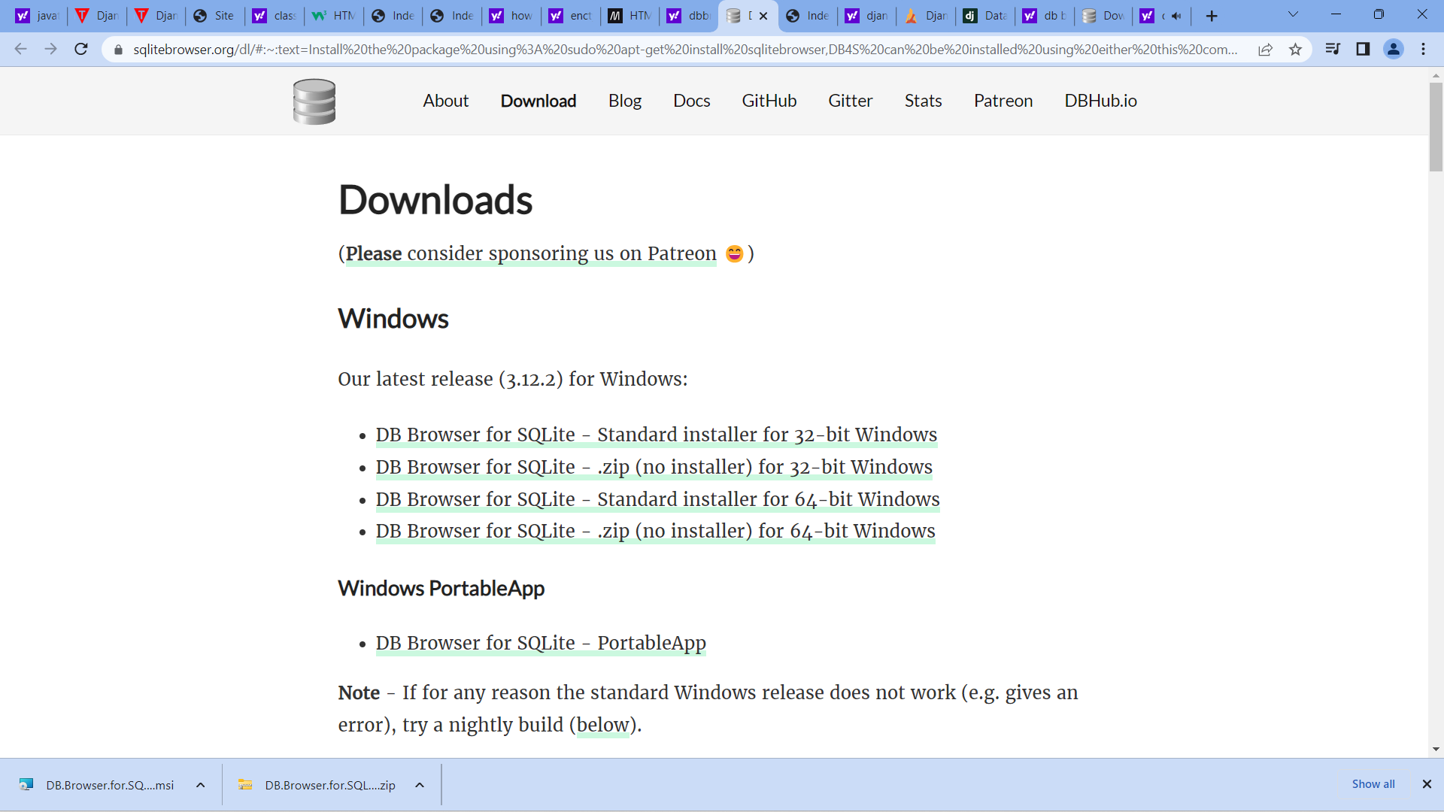

Slide 4
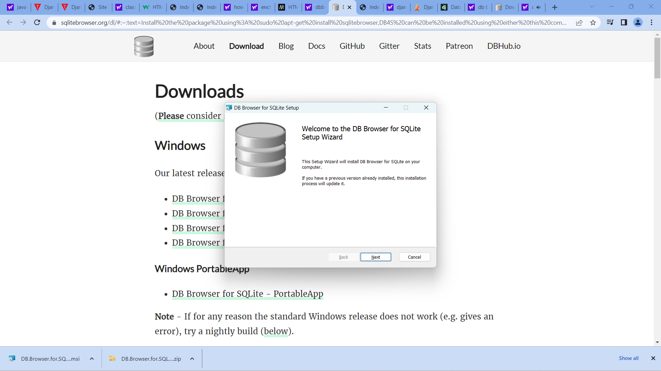

Slide 5
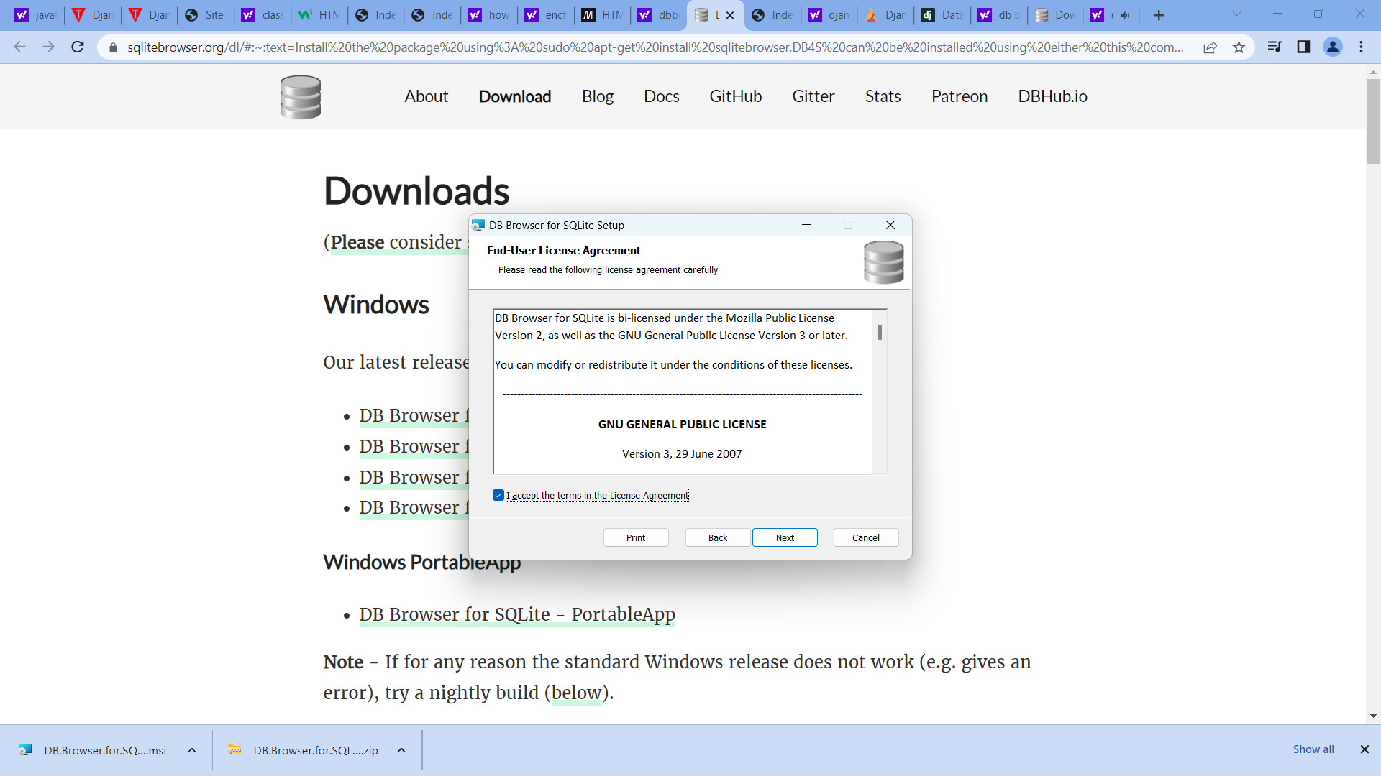

Slide 6
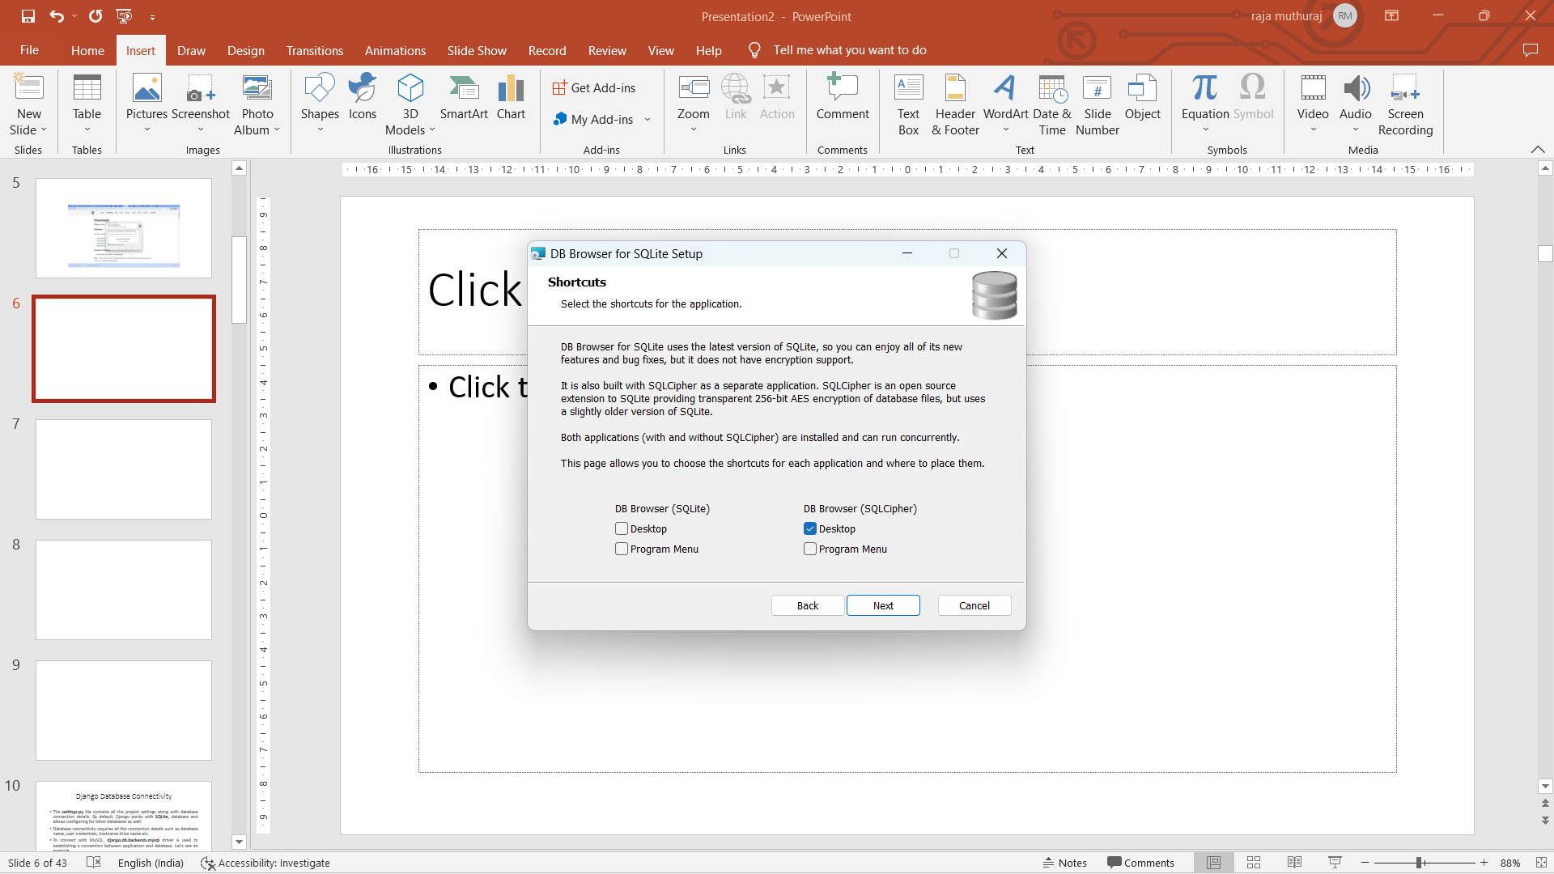

Slide 7
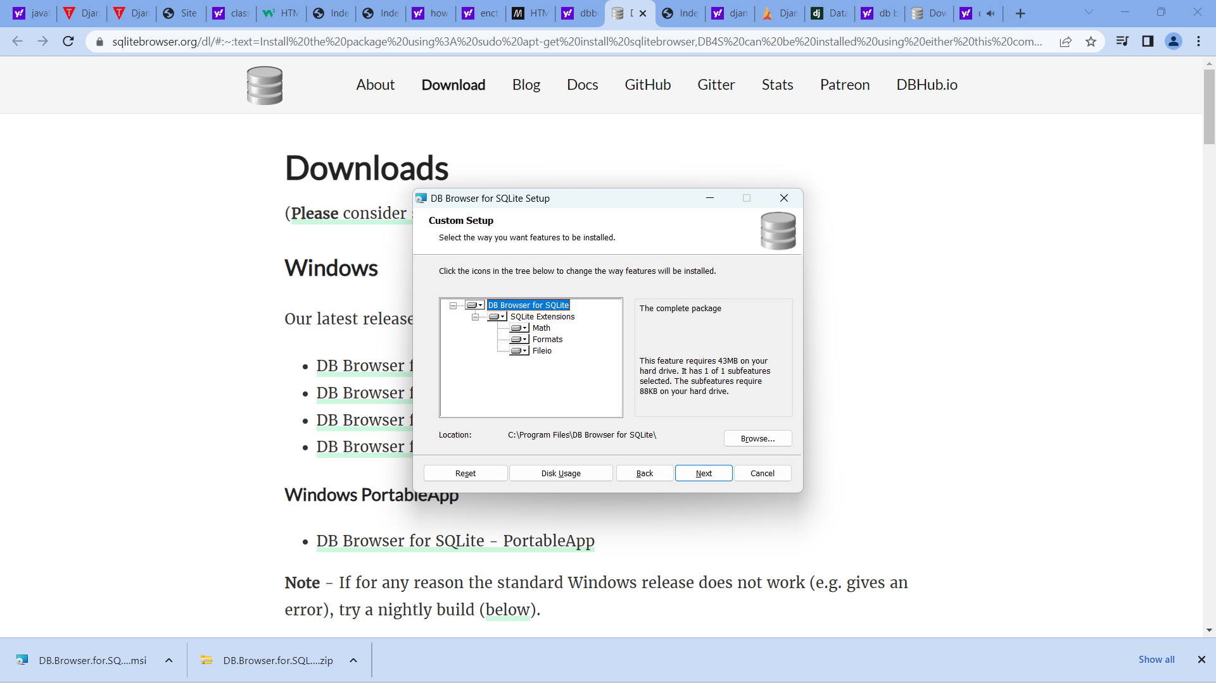

Slide 8
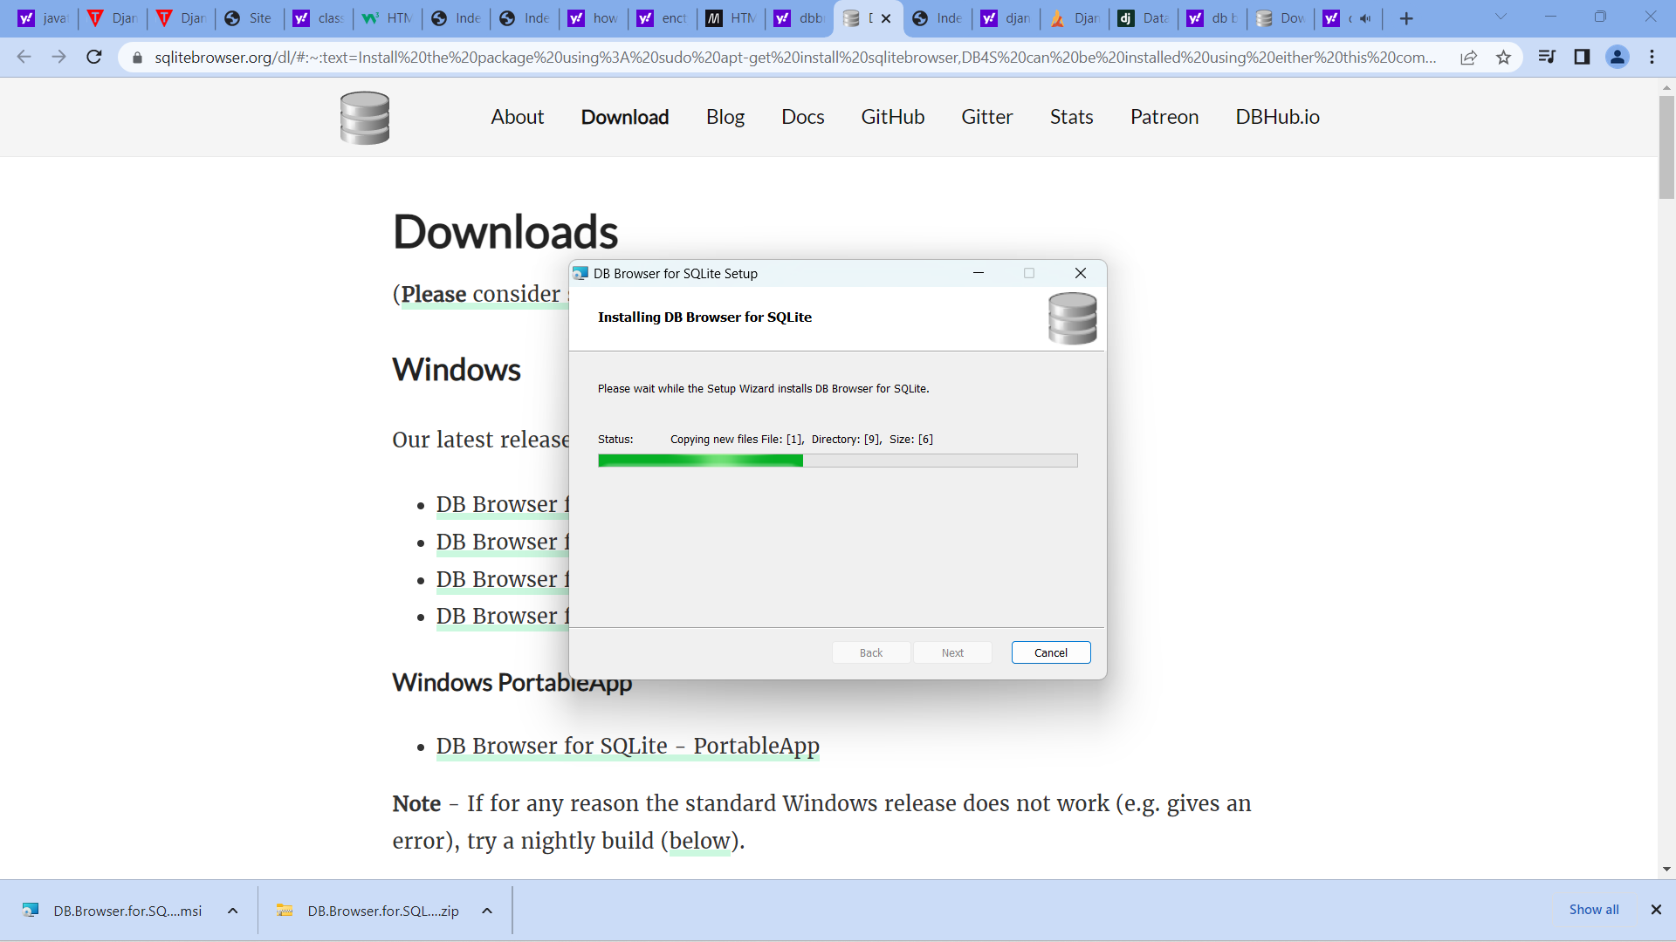

Slide 9
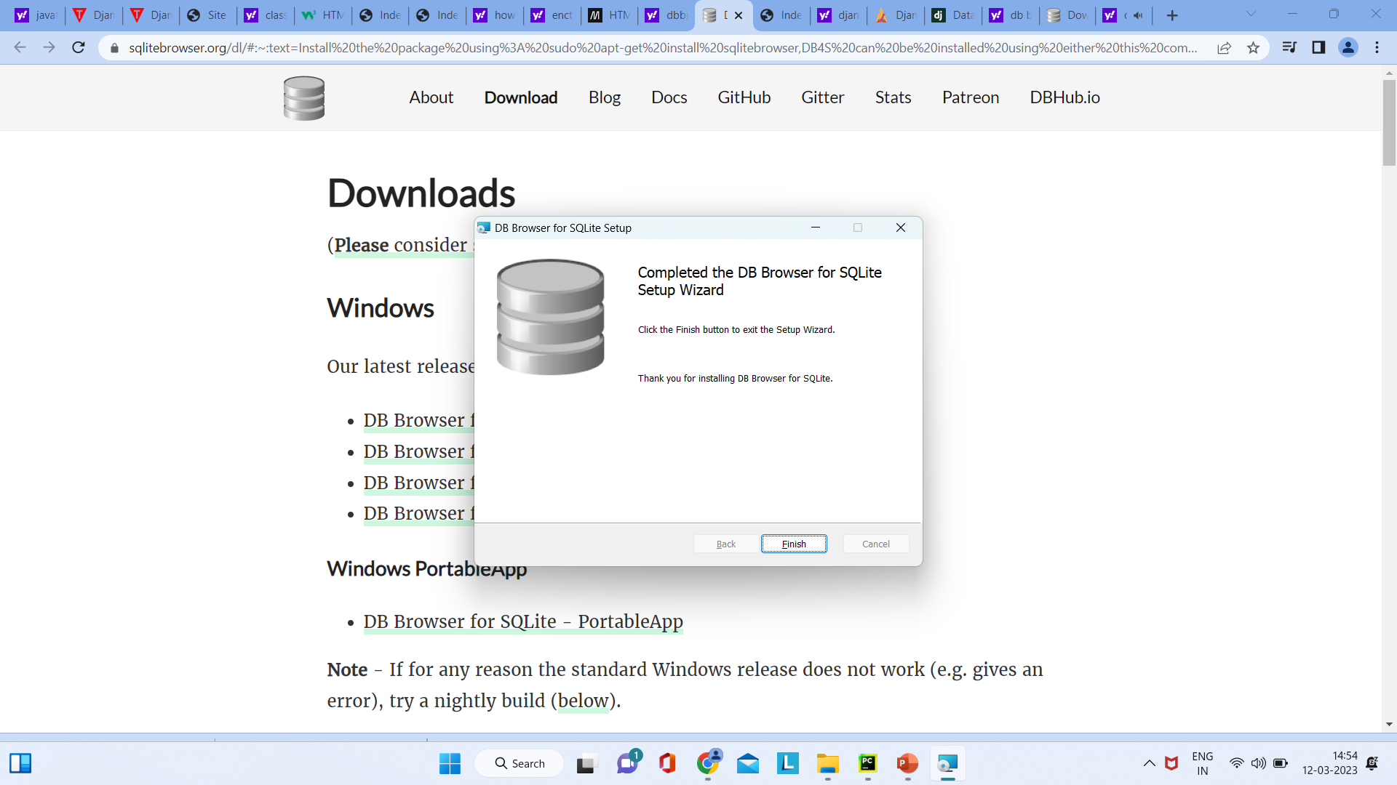

Slide 10
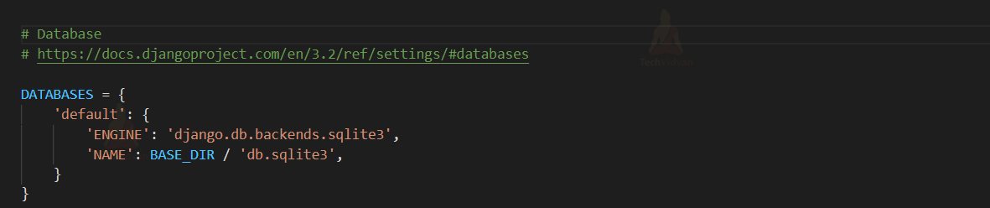
DATABASES Dictionary Indexes
To begin, find this section in the settings.py file of our web
application/project.
This segment contains information about the database connection.

Slide 11
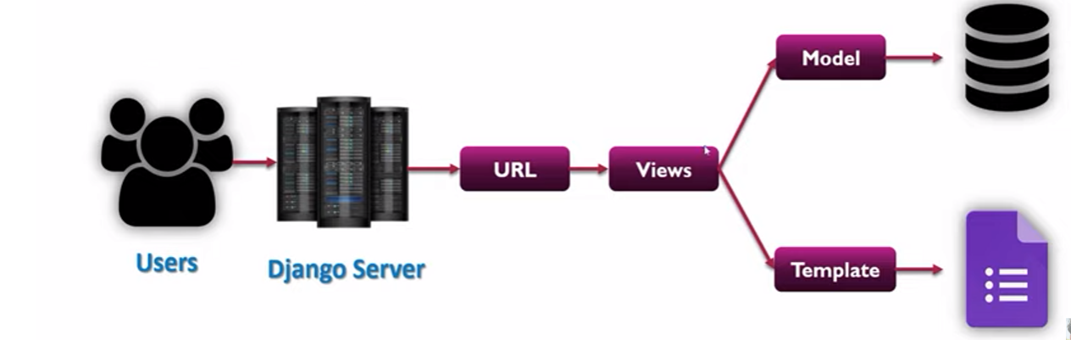
Database Connectivity MVT Model

Slide 12
DATABASES
DATABASES is a pre-defined dictionary in Django Framework, with the value for the main database where all the data will be saved as an index.
There can be several databases because we require data backups as well, but there is only one default database, and we won’t be introducing any more databases for the time being.
The default store a dictionary with two indexes:
Engine
Name

Slide 13
ENGINE
When connected to a certain website, it specifies the library to be used.
We must include the file “django.db.backends.sqlite3” in the value, which is a python library for the sqlite3 database that will convert our python code to the database language.
As a result, we won’t need to learn any additional database languages because all of the code is written in Python.

Slide 14
Django Database Migrations
Migration is a way of applying changes that we have made to a model, into the database schema.
Django creates a migration file inside the migration folder for each model to create the table schema, and each table is mapped to the model of which migration is created.
Django provides the various commands that are used to perform migration related tasks.
After creating a model, we can use these commands.

Slide 15
makemigrations : It is used to create a migration file that contains code for the tabled schema of a model.
migrate : It creates table according to the schema defined in the migration file.
sqlmigrate : It is used to show a raw SQL query of the applied migration.
showmigrations : It lists out all the migrations and their status.

Slide 16
Django ENGINE values for various databases
Database | Django ENGINE value | Required package
MySQL | “django.db.backends.mysql” | None, it’s included with Django
MariaDB | “django.db.backends.mysql” | None, it’s included with Django
Oracle | “django.db.backends.oracle” | None, it’s included with Django
PostgreSQL | “django.db.backends.postgresql_psycopg2” | None, it’s included with Django
SQLite | “django.db.backends.sqlite3” | None, it’s included with Django
SAP (Sybase) SQL Anywhere | “sqlany_django” | “pip install sqlany-django”
IBM DB2 | “ibm_db_django” | “pip install ibm_db_django”
Firebird | “firebird” | “pip install django-firebird”

Slide 17
NAME
The name of the database we are using, as well as its location, are here. The value of this parameter varies depending on the database we are using. We can play around with the database file here.
We are also supplying the database file name, or if one doesn’t exist, the db.sqlite3 file will be created. If we rename the file to db1.sqlite3 or something else, it will be created in our root directory every time we run the server.

Slide 18
SQLite
Django supports SQLite 3.9.0 and later.
SQLite current version 3.45.1
SQLite provides an excellent development alternative for applications that are predominantly read-only or require a smaller installation footprint.
As with all database servers, though, there are some differences that are specific to SQLite that we should be aware of.

Slide 19
Step by step process for DB Connectivity
Create project dbroject using django-admin startproject dbproject
Change directory to dbproject
Create an app using django-admin startapp dbapp
In settings.py add the app name we created

Slide 20
models.py
from django.db import models
class Employee(models.Model):
eid = models.CharField(max_length=20)
ename = models.CharField(max_length=100)
econtact = models.CharField(max_length=15)
address = models.CharField(max_length= 50)
class Meta:
db_table = "employee"

Slide 21
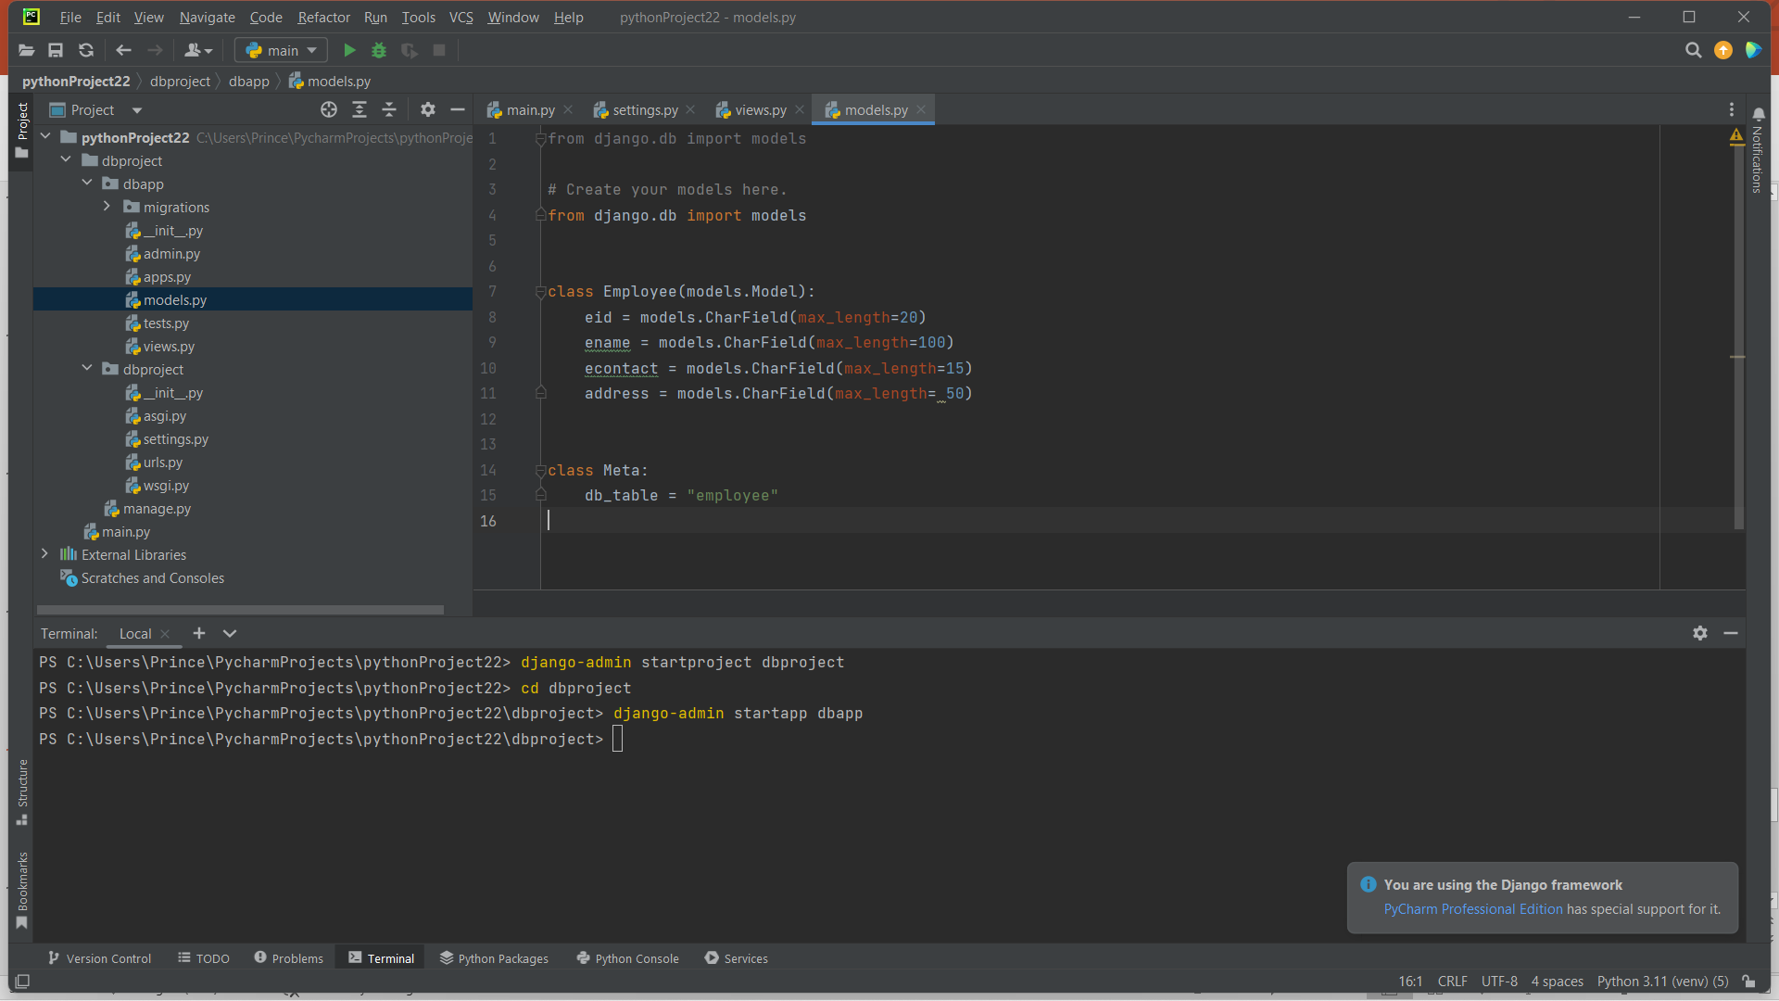

Slide 22
Create python a file in the formapp name as form.py
form.py
from django import forms
from .models import Employee
class EmployeeForm(forms.ModelForm):
class Meta:
model = Employee
fields = "__all__"

Slide 23
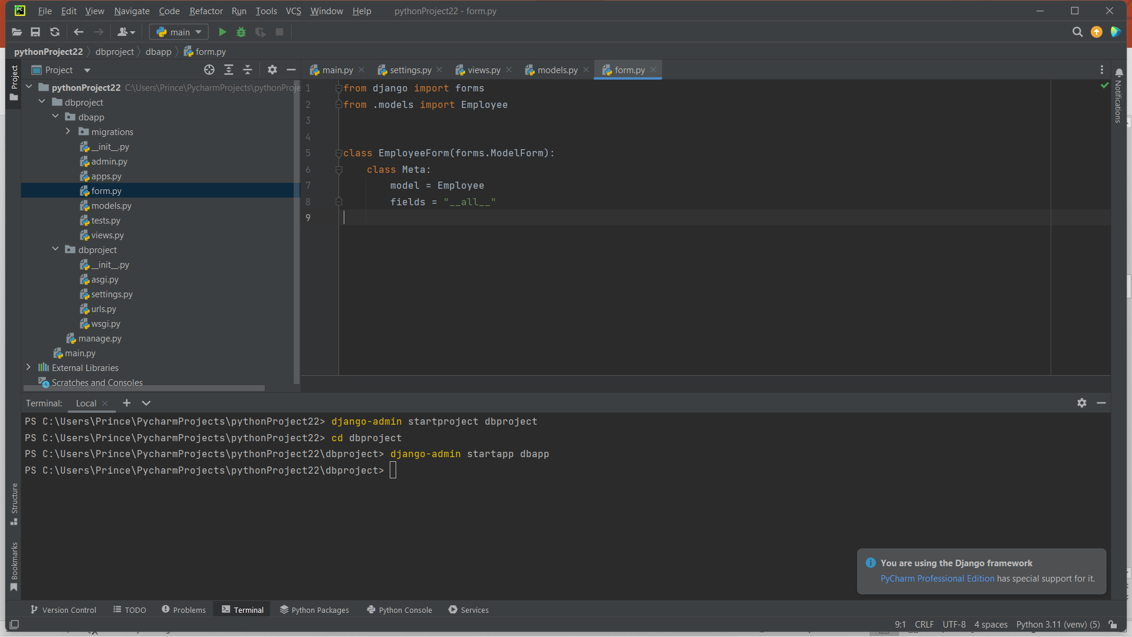

Slide 24
Create a directory name it as template and in the template create an index.html file
<!DOCTYPE html>
<html lang="en">
<head>
<meta charset="UTF-8">
<title>Index</title>
<link href="https://cdn.jsdelivr.net/npm/bootstrap@5.0.2/dist/css/bootstrap.min.css" rel="stylesheet" >
</head> <body>
<form method="POST" class="post-form" enctype="multipart/form-data" autocomplete="off">
{% csrf_token %}
{{ form.as_p }}
<label for="eid">Employee ID:</label>
<input type="text" id="eid" name="eid"><br> <br>
<label for="ename">Employee name:</label>
<input type="text" id="ename" name="ename"><br> <br>
<label for="econtact">Employee Contact:</label>

Slide 25
<input type="text" id="econtact" name="econtact"><br> <br>
<label for="address">Employee address:</label>
<input type="text" id="address" name="address"><br> <br>
<button class="btn btn-primary" type="submit">Save</button>
<button class="btn btn-danger" type="button" >Cancel</button>
</form>
</body>
</html>

Slide 26
Views.py
# Create your views here.
from .form import EmployeeForm
from .models import Employee
# Create your views here.
def emp(request):
if request.method == "POST":
eid = request.POST['eid']
ename = request.POST['ename']
econtact = request.POST['econtact']
address = request.POST['address']
obj=Employee();
obj.eid = eid
obj.ename= ename
obj.econtact= econtact
obj.address =address
obj.save()
return render(request, 'index.html')

Slide 27
Urls.py of project
from django.contrib import admin
from django.urls import path, include
urlpatterns = [
path('admin/', admin.site.urls),
path('', include(“dbapp.urls")),
]

Slide 28
Copy the urls.py of project and paste in formapp
from django.urls import path
from . import views
urlpatterns = [
path("", views.emp)
]

Slide 29
admin.py
from django.contrib import admin
# Register your models here.
from .models import Employee
admin.site.register(Employee)

Slide 30
from django.shortcuts import render
from .models import Employee
# Create your views here.
def emp(request):
if request.method == "POST":
eid = request.POST['eid']
ename = request.POST['ename']
econtact = request.POST['econtact']
address = request.POST['address']
obj=Employee()
obj.eid = eid
obj.ename= ename
obj.econtact= econtact
obj.address =address
obj.save()
return render(request, 'index.html')

Slide 31
Give command python manage.py makemigrations dbapp
Python manage.py migrate

Slide 32
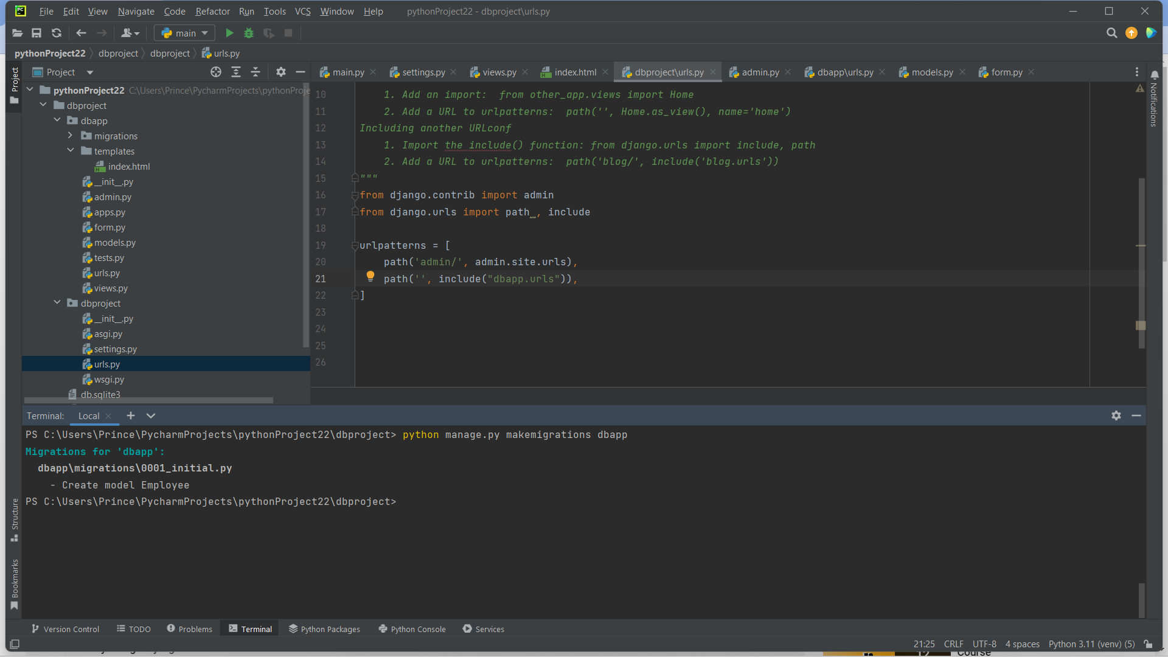

Slide 33
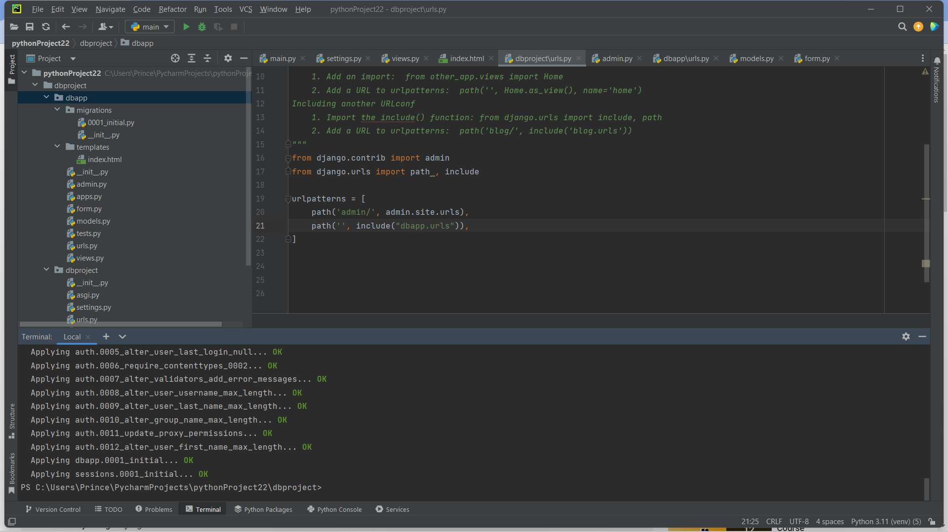
Give python manage.py migrate command

Slide 34
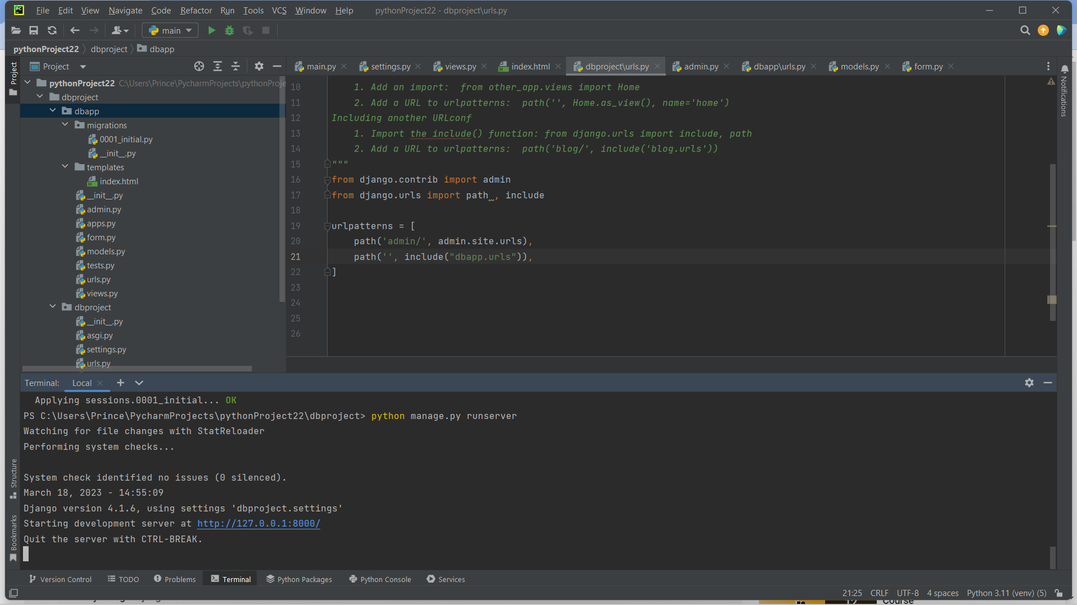

Slide 35
Then run the server using the command
python manage.py runserver
Click on the url to view the result

Slide 36
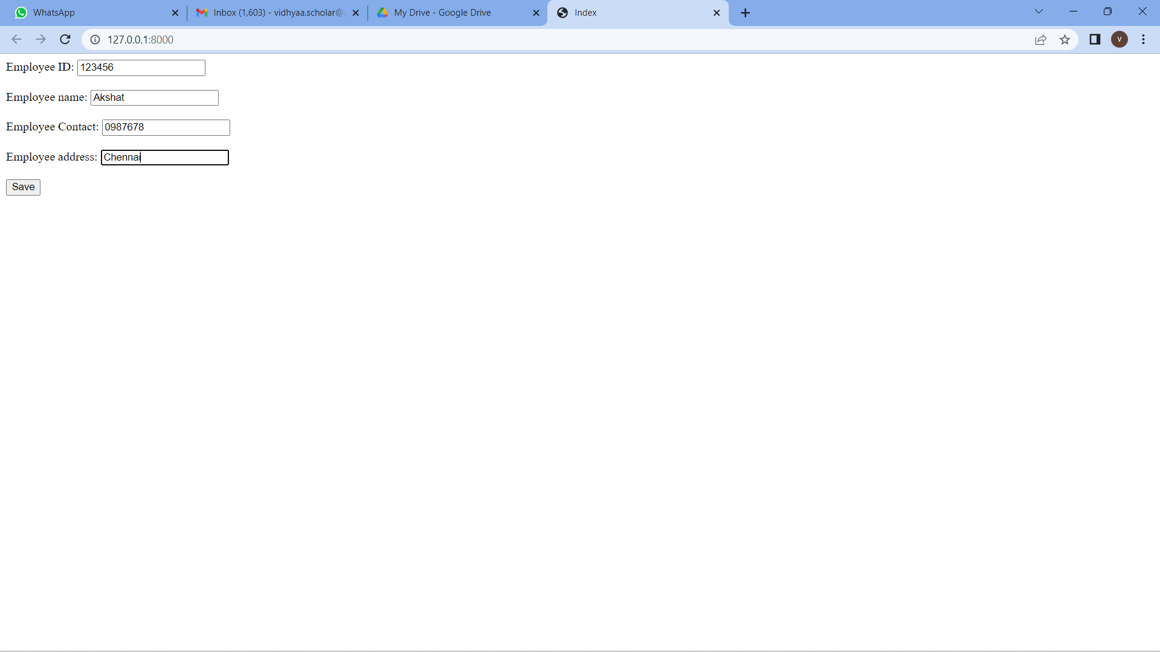

Slide 37
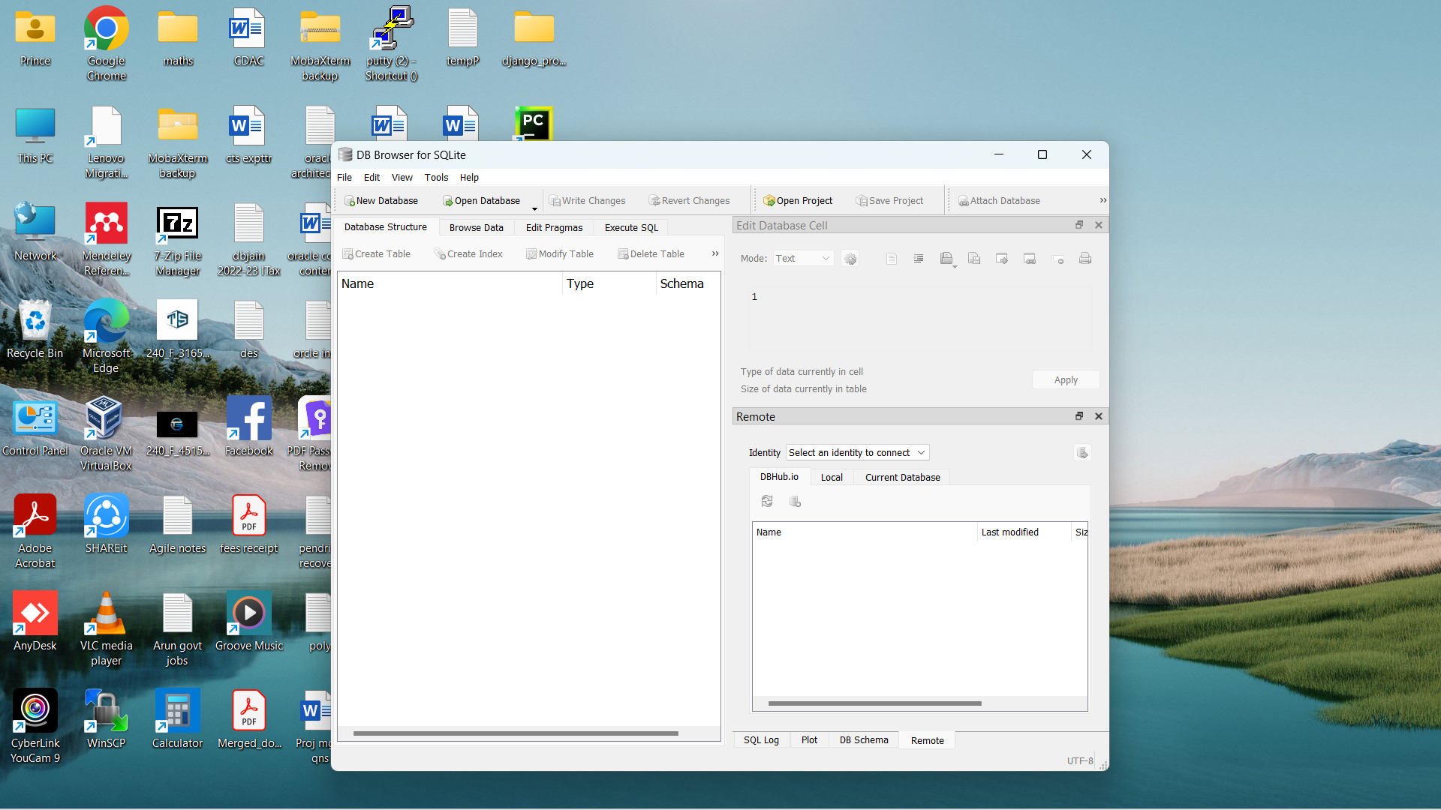
Open dbbrowser

Slide 38
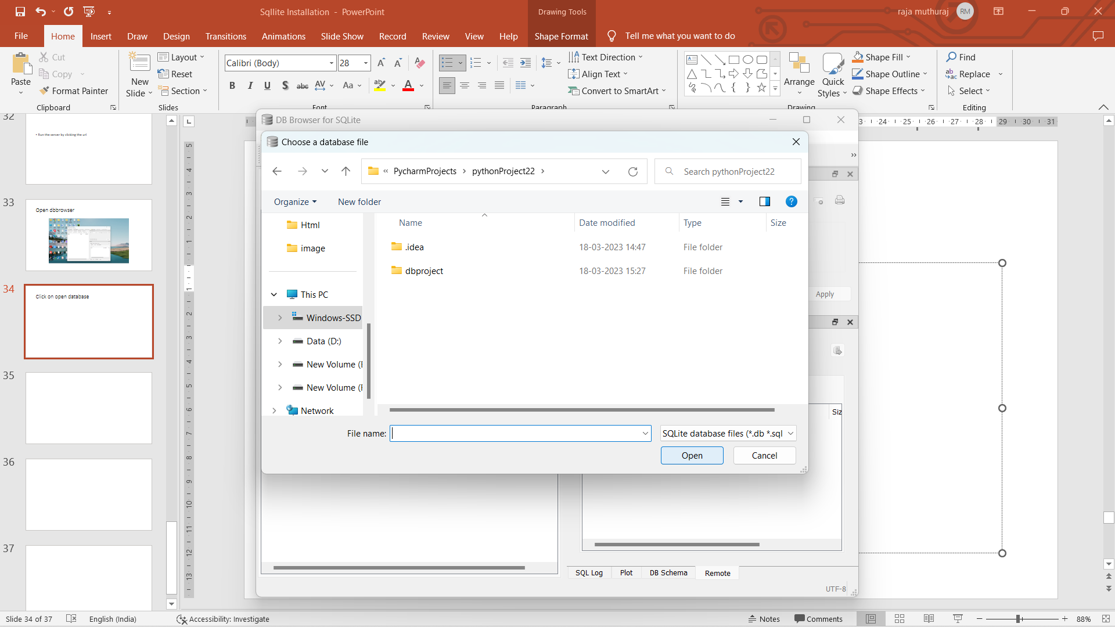
Give the path where pycharm project is stored

Slide 39
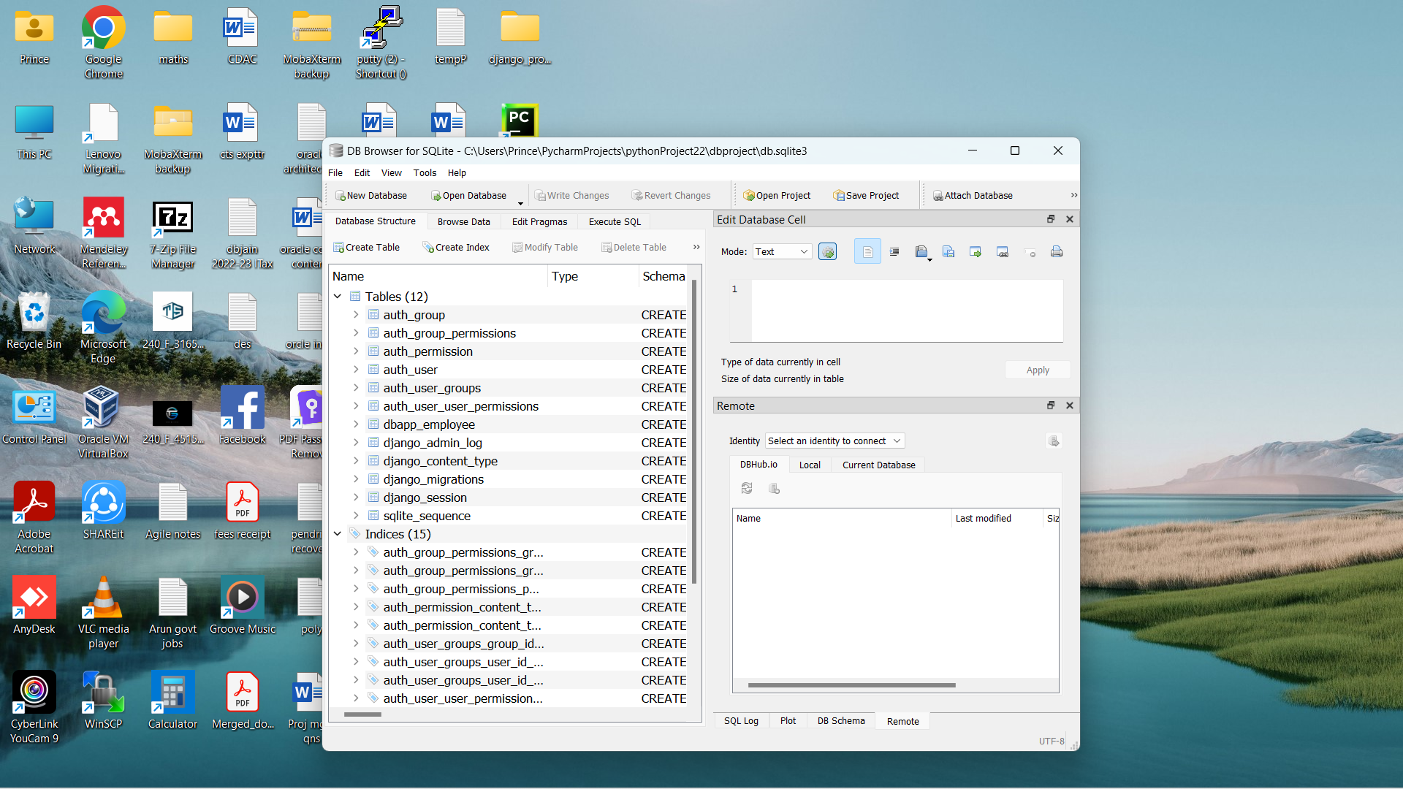
Open db.sqlite3 file

Slide 40
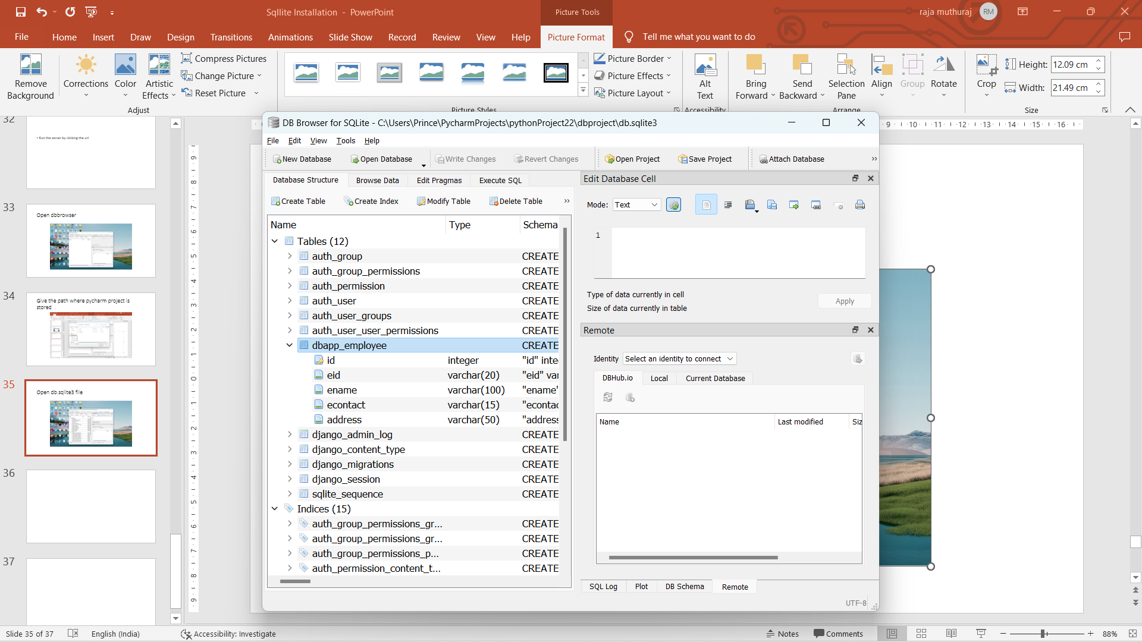
Our table is there in that click on the table name to view the fields we created in table

Slide 41
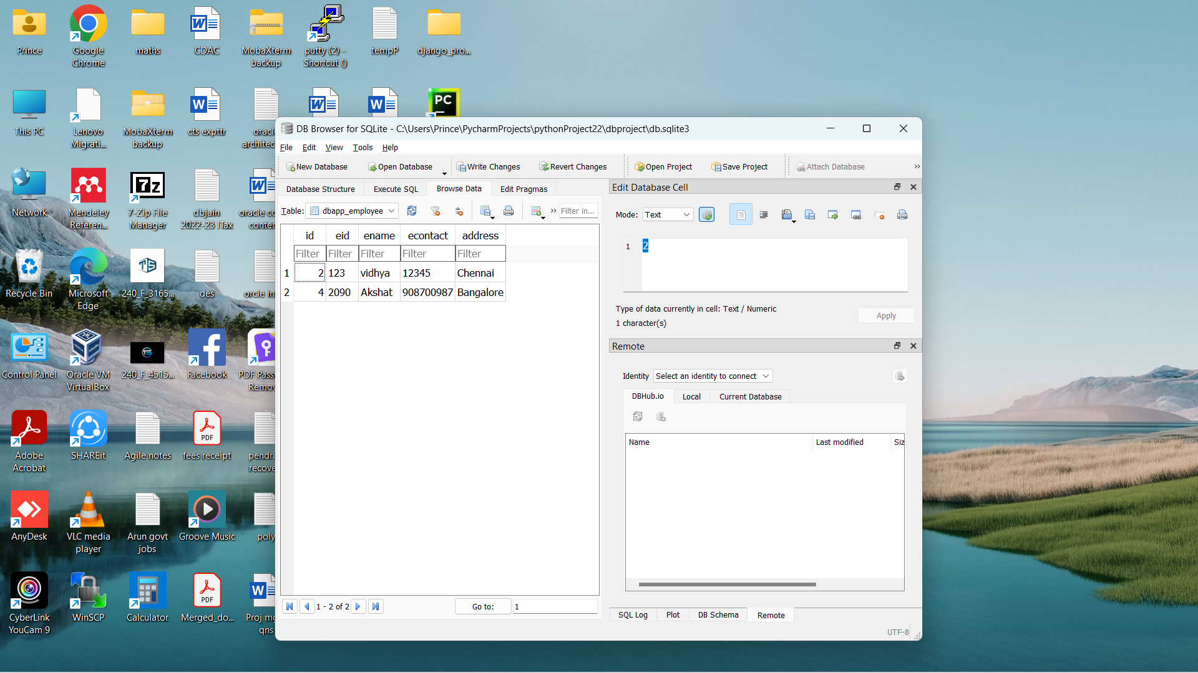
Goto browse data and select the table name to view the records we created

Slide 42
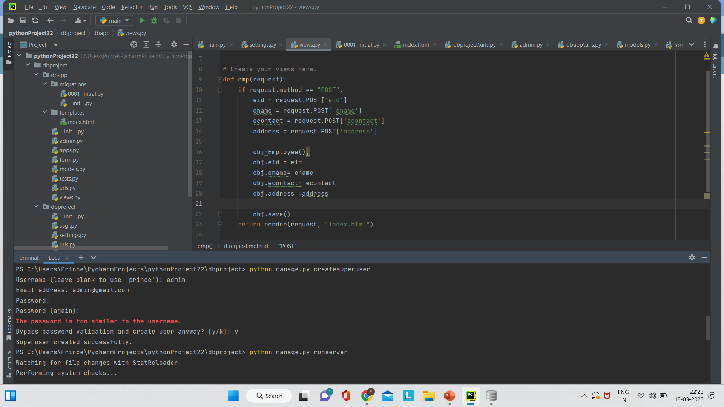
Create a superuser from the terminal

Slide 43
Run the server using python manage.py runserver
Click on the url and go to admin

Slide 44
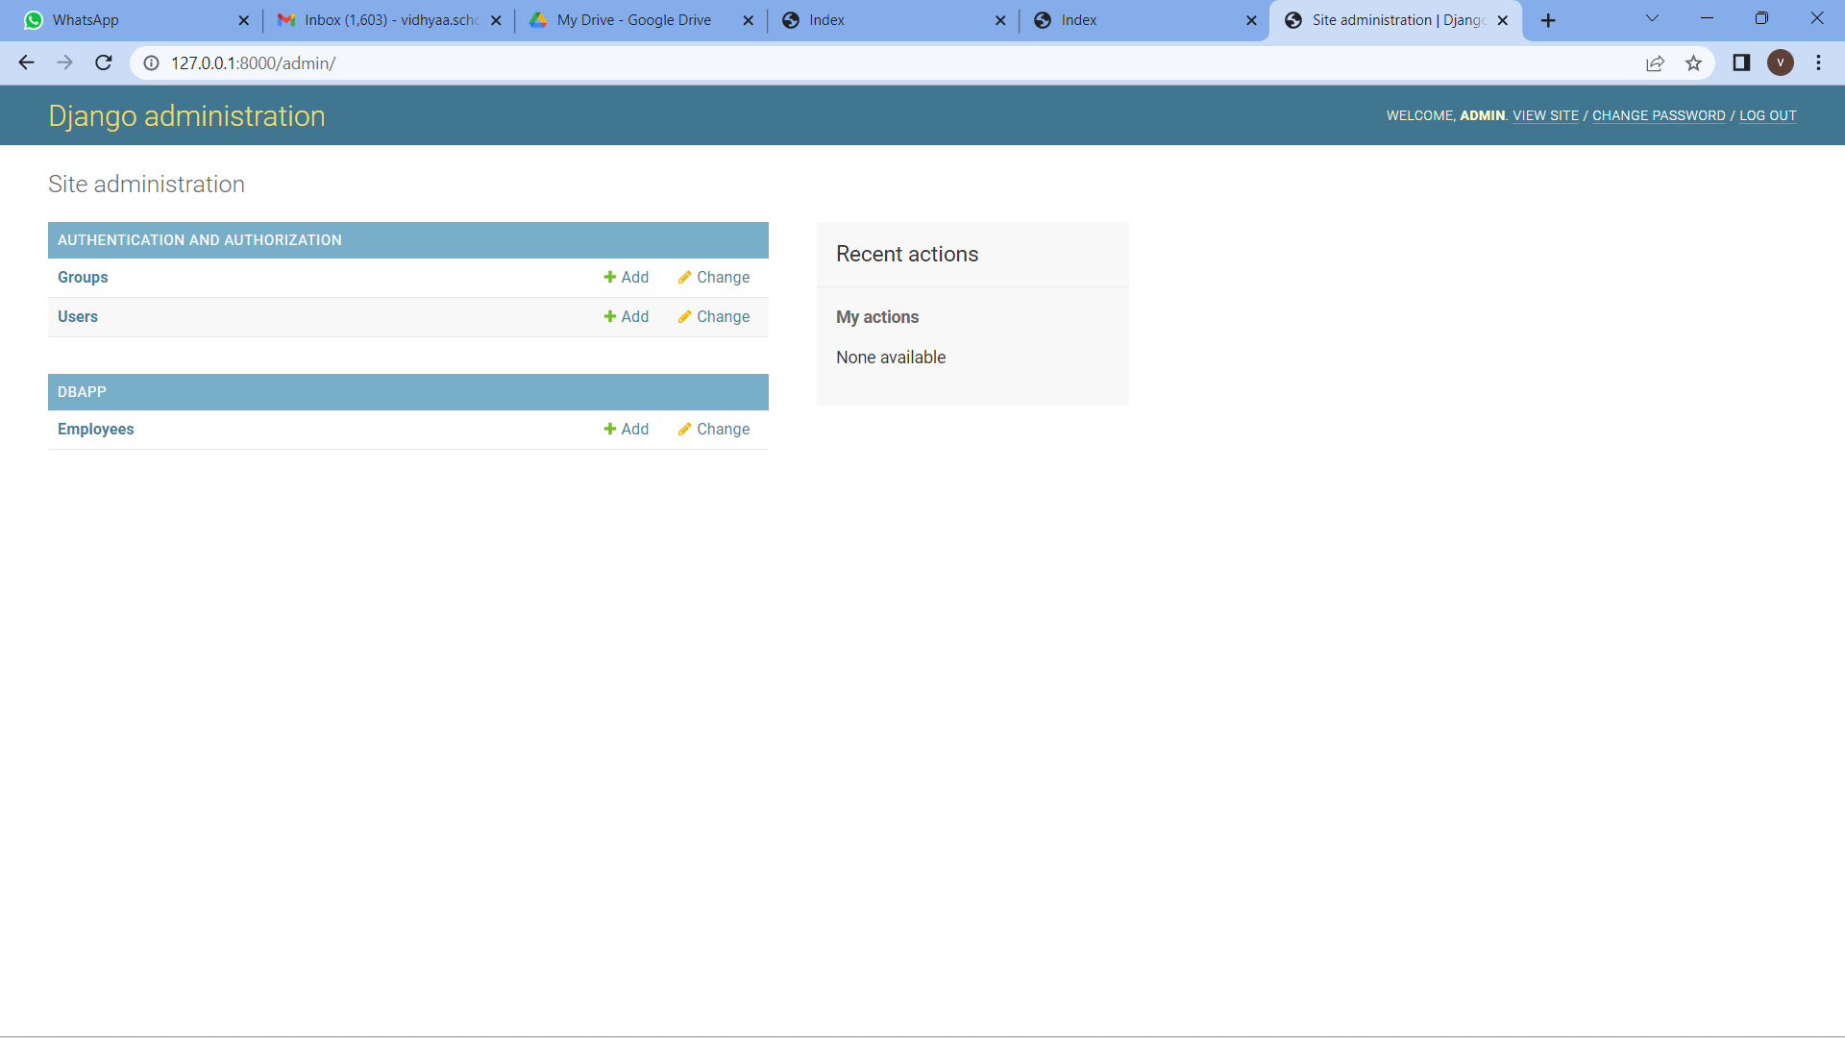

Slide 45
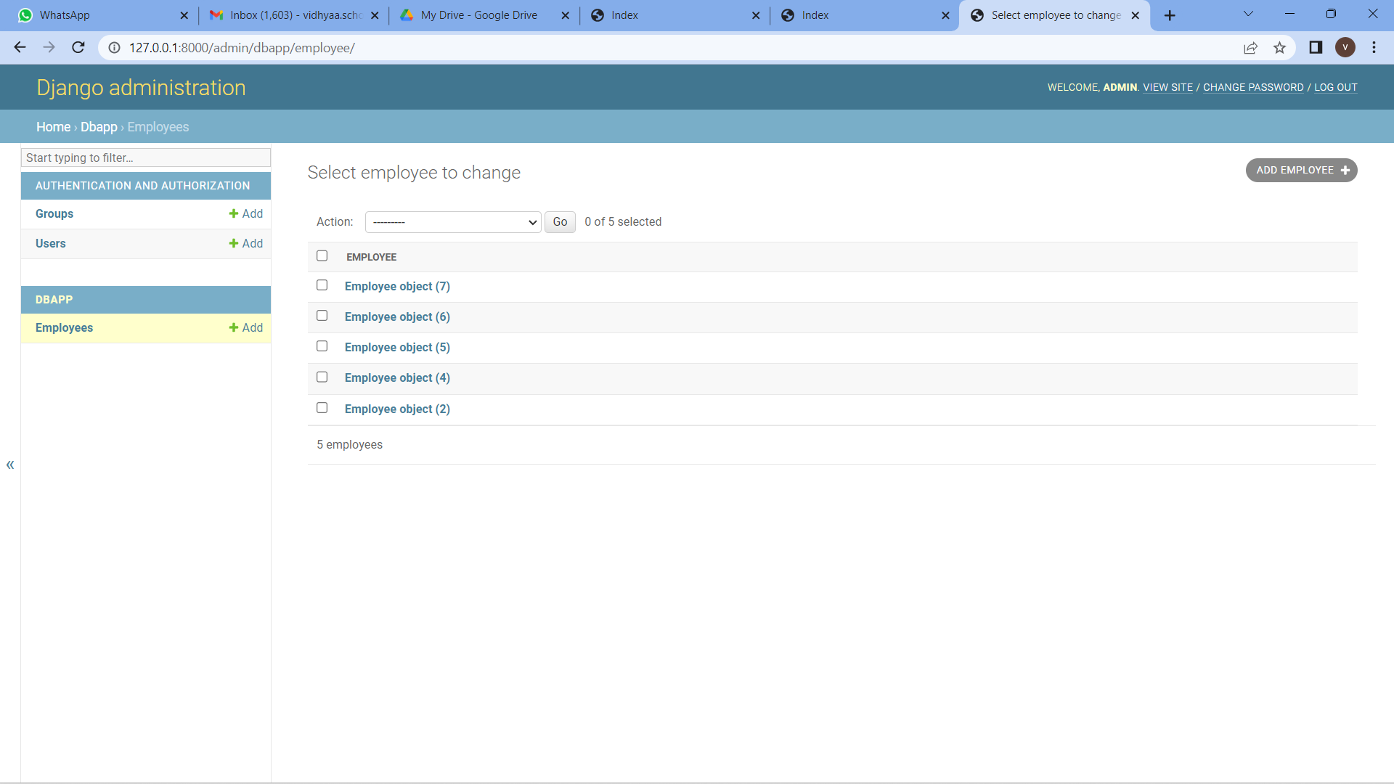
Click on the table employee from admin

Slide 46
Records we inserted are shown as employee object

Slide 47
Django Request and Response
The client-server architecture includes two major components request and response. The Django framework uses client-server architecture to implement web applications.
When a client requests for a resource, a HttpRequest object is created and correspond view function is called that returns HttpResponse object.
To handle request and response, Django provides HttpRequest and HttpResponse classes. Each class has its own attributes and methods.
Let's have a look at the HttpRequest class.

Slide 48
Django HttpRequest
This class is defined in the django.http module and used to handle the client request. Following are the attributes of this class.

Slide 49
Django HttpRequest Attributes
Attribute | Description
HttpRequest.scheme | A string representing the scheme of the request (HTTP or HTTPs usually).
HttpRequest.body | It returns the raw HTTP request body as a byte string.
HttpRequest.path | It returns the full path to the requested page does not include the scheme or domain.
HttpRequest.path_info | It shows path info portion of the path.
HttpRequest.method | It shows the HTTP method used in the request.
HttpRequest.encoding | It shows the current encoding used to decode form submission data.
HttpRequest.content_type | It shows the MIME type of the request, parsed from the CONTENT_TYPE header.

Slide 50
HttpRequest.content_params | It returns a dictionary of key/value parameters included in the CONTENT_TYPE header.
HttpRequest.GET | It returns a dictionary-like object containing all given HTTP GET parameters.
HttpRequest.POST | It is a dictionary-like object containing all given HTTP POST parameters.
HttpRequest.COOKIES | It returns all cookies available.
HttpRequest.FILES | It contains all uploaded files.
HttpRequest.META | It shows all available Http headers.
HttpRequest.resolver_match | It contains an instance of ResolverMatch representing the resolved URL.

Slide 51
Django HttpRequest Methods
Attribute | Description
HttpRequest.get_host() | It returns the original host of the request.
HttpRequest.get_port() | It returns the originating port of the request.
HttpRequest.get_full_path() | It returns the path, plus an appended query string, if applicable.
HttpRequest.build_absolute_uri (location) | It returns the absolute URI form of location.
HttpRequest.get_signed_cookie (key, default=RAISE_ERROR, salt='', max_age=None) | It returns a cookie value for a signed cookie, or raises a django.core.signing.BadSignature exception if the signature is no longer valid.
HttpRequest.is_secure() | It returns True if the request is secure; that is, if it was made with HTTPS.
HttpRequest.is_ajax() | It returns True if the request was made via an XMLHttpRequest.

Slide 52
Django HttpRequest Example
views.py
def methodinfo(request):
return HttpResponse("Http request is: "+request.method)

Slide 53
urls.py
path('info',views.methodinfo)

Slide 54
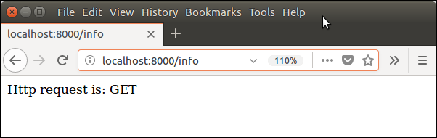
Output

Slide 55
Django HttpResponse
This class is a part of django.http module. It is responsible for generating response corresponds to the request and back to the client.
This class contains various attributes and methods that are given below.

Slide 56
Django HttpResponse Attributes
Attribute | Description
HttpResponse.content | A bytestring representing the content, encoded from a string if necessary.
HttpResponse.charset | It is a string denoting the charset in which the response will be encoded.
HttpResponse.status_code | It is an HTTP status code for the response.
HttpResponse.reason_phrase | The HTTP reason phrase for the response.
HttpResponse.streaming | It is false by default.
HttpResponse.closed | It is True if the response has been closed.

Slide 57
Django HttpResponse Methods
Method | Description
HttpResponse.__init__(content='', content_type=None, status=200, reason=None, charset=None) | It is used to instantiate an HttpResponse object with the given page content and content type.
HttpResponse.__setitem__(header, value) | It is used to set the given header name to the given value.
HttpResponse.__delitem__(header) | It deletes the header with the given name.
HttpResponse.__getitem__(header) | It returns the value for the given header name.
HttpResponse.has_header(header) | It returns either True or False based on a case-insensitive check for a header with the provided name

Slide 58
HttpResponse.setdefault(header, value) | It is used to set default header.
HttpResponse.write(content) | It is used to create response object of file-like object.
HttpResponse.flush() | It is used to flush the response object.
HttpResponse.tell() | This method makes an HttpResponse instance a file-like object.
HttpResponse.getvalue() | It is used to get the value of HttpResponse.content.
HttpResponse.readable() | This method is used to create stream-like object of HttpResponse class.
HttpResponse.seekable() | It is used to make response object seekable.

Slide 59
Information responses
100 Continue
This interim response indicates that the client should continue the request or ignore the response if the request is already finished.
101 Switching Protocols
This code is sent in response to an Upgrade request header from the client and indicates the protocol the server is switching to.
102 Processing (WebDAV)
This code indicates that the server has received and is processing the request, but no response is available yet.
103 Early Hints
This status code is primarily intended to be used with the Link header, letting the user agent start preloading resources while the server prepares a response or preconnect to an origin from which the page will need resources.

Slide 60
Successful responses
200 OK
The request succeeded. The result meaning of "success" depends on the HTTP method:
GET: The resource has been fetched and transmitted in the message body.
HEAD: The representation headers are included in the response without any message body.
PUT or POST: The resource describing the result of the action is transmitted in the message body.
TRACE: The message body contains the request message as received by the server.
201 Created
The request succeeded, and a new resource was created as a result. This is typically the response sent after POST requests, or some PUT requests.

Slide 61
202 Accepted
The request has been received but not yet acted upon. It is noncommittal, since there is no way in HTTP to later send an asynchronous response indicating the outcome of the request. It is intended for cases where another process or server handles the request, or for batch processing.
203 Non-Authoritative Information
This response code means the returned metadata is not exactly the same as is available from the origin server, but is collected from a local or a third-party copy. This is mostly used for mirrors or backups of another resource. Except for that specific case, the 200 OK response is preferred to this status.
204 No Content
There is no content to send for this request, but the headers may be useful. The user agent may update its cached headers for this resource with the new ones.
205 Reset Content
Tells the user agent to reset the document which sent this request.

Slide 62
206 Partial Content
This response code is used when the Range header is sent from the client to request only part of a resource.
207 Multi-Status (WebDAV)
Conveys information about multiple resources, for situations where multiple status codes might be appropriate.
208 Already Reported (WebDAV)
Used inside a <dav:propstat> response element to avoid repeatedly enumerating the internal members of multiple bindings to the same collection.
226 IM Used (HTTP Delta encoding)
The server has fulfilled a GET request for the resource, and the response is a representation of the result of one or more instance-manipulations applied to the current instance.

Slide 63
Redirection messages
300 Multiple Choices
The request has more than one possible response. The user agent or user should choose one of them. (There is no standardized way of choosing one of the responses, but HTML links to the possibilities are recommended so the user can pick.)
301 Moved Permanently
The URL of the requested resource has been changed permanently. The new URL is given in the response.
302 Found
This response code means that the URI of requested resource has been changed temporarily. Further changes in the URI might be made in the future. Therefore, this same URI should be used by the client in future requests.
303 See Other
The server sent this response to direct the client to get the requested resource at another URI with a GET request.
304 Not Modified
This is used for caching purposes. It tells the client that the response has not been modified, so the client can continue to use the same cached version of the response.

Slide 64
305 Use Proxy Deprecated
Defined in a previous version of the HTTP specification to indicate that a requested response must be accessed by a proxy. It has been deprecated due to security concerns regarding in-band configuration of a proxy.
306 unused
This response code is no longer used; it is just reserved. It was used in a previous version of the HTTP/1.1 specification.
307 Temporary Redirect
The server sends this response to direct the client to get the requested resource at another URI with the same method that was used in the prior request. This has the same semantics as the 302 Found HTTP response code, with the exception that the user agent must not change the HTTP method used: if a POST was used in the first request, a POST must be used in the second request.
308 Permanent Redirect
This means that the resource is now permanently located at another URI, specified by the Location: HTTP Response header. This has the same semantics as the 301 Moved Permanently HTTP response code, with the exception that the user agent must not change the HTTP method used: if a POST was used in the first request, a POST must be used in the second request.

Slide 65
Client error responses
400 Bad Request
The server cannot or will not process the request due to something that is perceived to be a client error (e.g., malformed request syntax, invalid request message framing, or deceptive request routing).
401 Unauthorized
Although the HTTP standard specifies "unauthorized", semantically this response means "unauthenticated". That is, the client must authenticate itself to get the requested response.
402 Payment Required Experimental
This response code is reserved for future use. The initial aim for creating this code was using it for digital payment systems, however this status code is used very rarely and no standard convention exists.
403 Forbidden
The client does not have access rights to the content; that is, it is unauthorized, so the server is refusing to give the requested resource. Unlike 401 Unauthorized, the client's identity is known to the server.

Slide 66
404 Not Found
The server cannot find the requested resource. In the browser, this means the URL is not recognized. In an API, this can also mean that the endpoint is valid but the resource itself does not exist. Servers may also send this response instead of 403 Forbidden to hide the existence of a resource from an unauthorized client. This response code is probably the most well known due to its frequent occurrence on the web.
405 Method Not Allowed
The request method is known by the server but is not supported by the target resource. For example, an API may not allow calling DELETE to remove a resource.
406 Not Acceptable
This response is sent when the web server, after performing server-driven content negotiation, doesn't find any content that conforms to the criteria given by the user agent.
407 Proxy Authentication Required
This is similar to 401 Unauthorized but authentication is needed to be done by a proxy.
408 Request Timeout
This response is sent on an idle connection by some servers, even without any previous request by the client. It means that the server would like to shut down this unused connection. This response is used much more since some browsers, like Chrome, Firefox 27+, or IE9, use HTTP pre-connection mechanisms to speed up surfing. Also note that some servers merely shut down the connection without sending this message.
409 Conflict
This response is sent when a request conflicts with the current state of the server.

Slide 67
410 Gone
This response is sent when the requested content has been permanently deleted from server, with no forwarding address. Clients are expected to remove their caches and links to the resource. The HTTP specification intends this status code to be used for "limited-time, promotional services". APIs should not feel compelled to indicate resources that have been deleted with this status code.
411 Length Required
Server rejected the request because the Content-Length header field is not defined and the server requires it.
412 Precondition Failed
The client has indicated preconditions in its headers which the server does not meet.

Slide 68
413 Payload Too Large
Request entity is larger than limits defined by server. The server might close the connection or return an Retry-After header field.
414 URI Too Long
The URI requested by the client is longer than the server is willing to interpret.
415 Unsupported Media Type
The media format of the requested data is not supported by the server, so the server is rejecting the request.
416 Range Not Satisfiable
The range specified by the Range header field in the request cannot be fulfilled. It's possible that the range is outside the size of the target URI's data.
417 Expectation Failed
This response code means the expectation indicated by the Expect request header field cannot be met by the server.
418 I'm a teapot
The server refuses the attempt to brew coffee with a teapot.
421 Misdirected Request
The request was directed at a server that is not able to produce a response. This can be sent by a server that is not configured to produce responses for the combination of scheme and authority that are included in the request URI.

Slide 69
422 Unprocessable Content (WebDAV)
The request was well-formed but was unable to be followed due to semantic errors.
423 Locked (WebDAV)
The resource that is being accessed is locked.
424 Failed Dependency (WebDAV)
The request failed due to failure of a previous request.
425 Too Early Experimental
Indicates that the server is unwilling to risk processing a request that might be replayed.
426 Upgrade Required
The server refuses to perform the request using the current protocol but might be willing to do so after the client upgrades to a different protocol. The server sends an Upgrade header in a 426 response to indicate the required protocol(s).

Slide 70
428 Precondition Required
The origin server requires the request to be conditional. This response is intended to prevent the 'lost update' problem, where a client GETs a resource's state, modifies it and PUTs it back to the server, when meanwhile a third party has modified the state on the server, leading to a conflict.
429 Too Many Requests
The user has sent too many requests in a given amount of time ("rate limiting").
431 Request Header Fields Too Large
The server is unwilling to process the request because its header fields are too large. The request may be resubmitted after reducing the size of the request header fields.
451 Unavailable For Legal Reasons
The user agent requested a resource that cannot legally be provided, such as a web page censored by a government.
Server error responses
500 Internal Server Error
The server has encountered a situation it does not know how to handle.

Slide 71
501 Not Implemented
The request method is not supported by the server and cannot be handled. The only methods that servers are required to support (and therefore that must not return this code) are GET and HEAD.
502 Bad Gateway
This error response means that the server, while working as a gateway to get a response needed to handle the request, got an invalid response.
503 Service Unavailable
The server is not ready to handle the request. Common causes are a server that is down for maintenance or that is overloaded. Note that together with this response, a user-friendly page explaining the problem should be sent. This response should be used for temporary conditions and the Retry-After HTTP header should, if possible, contain the estimated time before the recovery of the service. The webmaster must also take care about the caching-related headers that are sent along with this response, as these temporary condition responses should usually not be cached.
504 Gateway Timeout
This error response is given when the server is acting as a gateway and cannot get a response in time.
505 HTTP Version Not Supported
The HTTP version used in the request is not supported by the server.

Slide 72
The server has an internal configuration error: the chosen variant resource is configured to engage in transparent content negotiation itself, and is therefore not a proper end point in the negotiation process.
507 Insufficient Storage (WebDAV)
The method could not be performed on the resource because the server is unable to store the representation needed to successfully complete the request.
508 Loop Detected (WebDAV)
The server detected an infinite loop while processing the request.
510 Not Extended
Further extensions to the request are required for the server to fulfill it.
511 Network Authentication Required
Indicates that the client needs to authenticate to gain network access.

